Slide 1
3장. Dynamic Programming (동적 계획)
3-1. Binomial Coefficient (이항 계수)
3-2. Floyd’s Algorithm for Shortest Paths
(프로이드의 최단경로 알고리즘)

Slide 2
● Bottom-up approach to problem solving
● Instance of problem divided into smaller instances
● Smaller instances solved first and stored for later use by solution
to solve larger instances
● Look it up instead of re-compute
● Iterative solution to the Fibonacci Sequence
● In a dynamic programming algorithm, we construct a solution from the
bottom up in an array (or sequence of arrays).

Slide 3
▣ Steps to develop a dynamic programming algorithm
Establish a recursive property that gives the solution to
an instance of the problem
2. Compute the value of an optimal solution in a bottom-up
fashion by solving smaller instances first

Slide 4
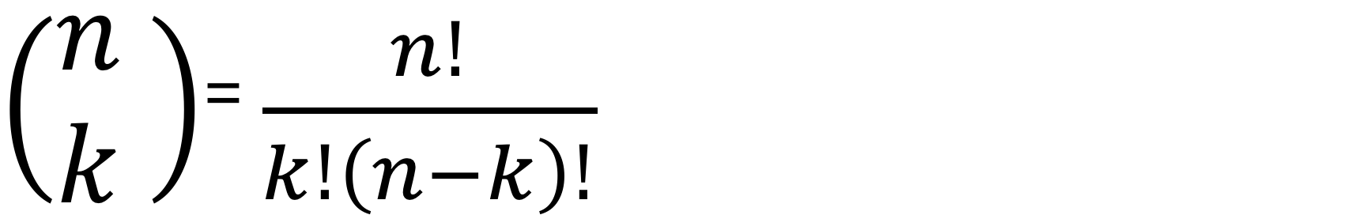
3-1. Binomial Coefficient (이항 계수)
● The binomial coefficient, which is discussed in Section A.7 in Appendix A,
is given by

Slide 5
▣ [Algorithm 3.1] Binomial Coefficient Using Divide-and-Conquer
(이항계수) (Recursive Version)
Problem: Compute the binomial coefficient.
Inputs: nonnegative integers n and k, where k ≤ n.
Outputs: bin, the binomial coefficient nCk.
int bin (int n, int k) { if (k == 0 || n == k) return 1; else return bin(n-1, k-1) + bin(n-1, k); }

Slide 6

▣ [문제 1] : Establish Equality 3-1.
$\left(\begin{aligned}n \\ k\end{aligned}\right)= \frac{ n!}{ k!\left(n−k\right)! } for 0 ≤k ≤n.$
$\left(\begin{aligned}n \\ k\end{aligned}\right)= \left\{\begin{aligned}\left({n−1 \atop k−1}\right)+ \left({n−1 \atop k}\right) 0 <k <n \\ \\ 1 k=0 or k=n.\end{aligned}\right.$------ (3-1)

Slide 7
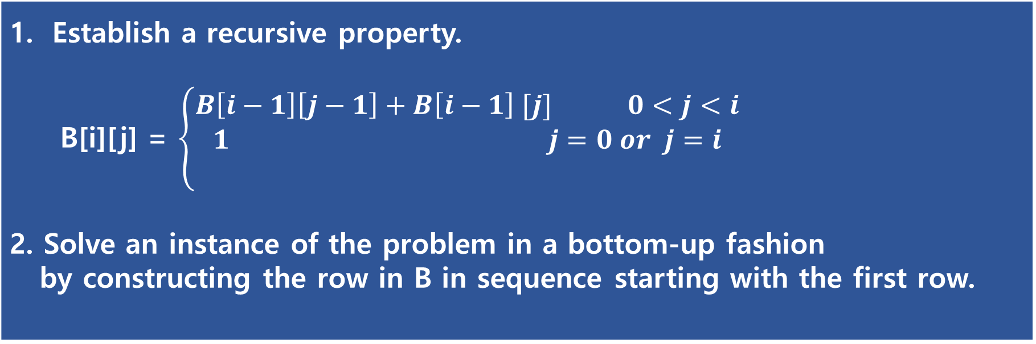
▣ Binomial Coefficient Using Dynamic Programming
● A more efficient algorithm is developed next using dynamic programming.
● The step for constructing a dynamic programming algorithm:
Establish a recursive property. B[i][j] = $\left\{\begin{aligned}B\left[i−1\right]\left[j−1\right]+B\left[i−1\right] [j] 0<j<i \\ 1 j=0 or j=i \\ \end{aligned}\right.$ 2. Solve an instance of the problem in a bottom-up fashion by constructing the row in B in sequence starting with the first row.

Slide 8
▣ [Algorithm 3.2] Binomial Coefficient Using Dynamic Programming
Problem: Compute the binomial coefficient.
Inputs: nonnegative integers n and k, where k ≤ n.
Outputs: bin2, the binomial coefficient nCk.
int bin2 (int n, int k) { index i, j; int B[0..n][0..k]; for (i = 0; i <= n; i++) for (j = 0; j <= minimum(i, k); j++) if (j == 0 || j == i) B[i][j] = 1; else B[i][j] = B[i-1][j-1] + B[i-1][j]; return B[n][k]; }

Slide 9
● [그림 3.1] : The array B used for compute
the binomial coefficient.

Slide 10
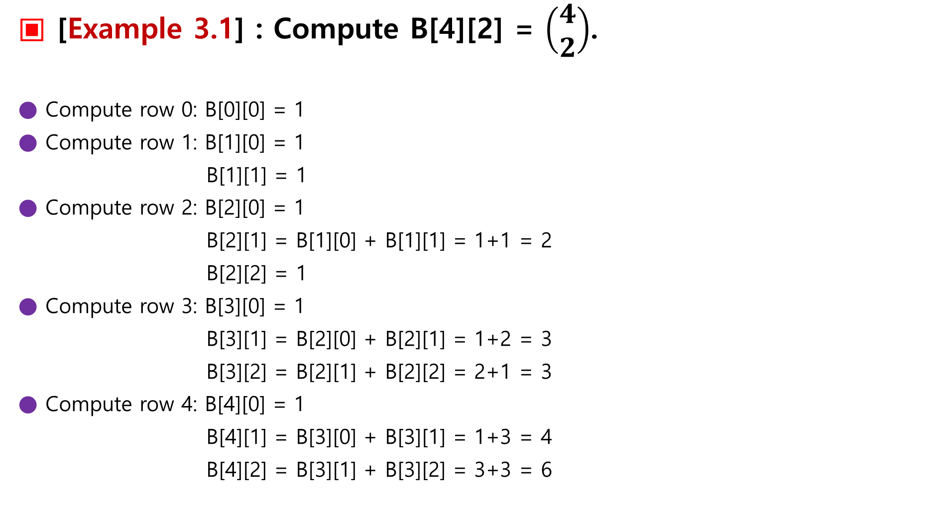
▣ [Example 3.1] : Compute B[4][2] = $\left(\begin{aligned}4 \\ 2\end{aligned}\right)$.
● Compute row 0: B[0][0] = 1
● Compute row 1: B[1][0] = 1
B[1][1] = 1
● Compute row 2: B[2][0] = 1
B[2][1] = B[1][0] + B[1][1] = 1+1 = 2
B[2][2] = 1
● Compute row 3: B[3][0] = 1
B[3][1] = B[2][0] + B[2][1] = 1+2 = 3
B[3][2] = B[2][1] + B[2][2] = 2+1 = 3
● Compute row 4: B[4][0] = 1
B[4][1] = B[3][0] + B[3][1] = 1+3 = 4
B[4][2] = B[3][1] + B[3][2] = 3+3 = 6

Slide 11

▣ [문제 1] : 다음 물음에 답하여라.
1. (a + b)⁷의 전개식에서 a⁴b³의 계수를 구하여라.
2. $(2x+ \frac{1}{x})^{8}$의 전개식에서 상수항과 x⁴의 계수, $\frac{1}{x^{2}}$의 계수를
구하여라.

Slide 12

● [풀이] :
1. (a + b)⁷의 전개식에서 a⁴b³의 계수를 구하여라.
₇C₃ = 35
2. $(2x+ \frac{1}{x})^{8}$의 전개식에서 상수항과 x⁴의 계수, $\frac{1}{x^{2}}$의 계수를
구하여라.
(1) ₈C₄ (2x)⁴ (1/x)⁴ = 1120
(2) ₈C₂ (2x)⁶ (1/x)² = ₈C₂ * (2)⁶ * x⁴ = 28 * 64 = 1792
(3) ₈C₅ (2x)³ (1/x)⁵ = ₈C₅ * (2)³ * 1/x² = 56 * 8 = 448

Slide 13
3.2 Floyd’s Algorithm for Shortest Paths
● The graph is called a weighted graph.
In many applications, they represent distances.

Slide 14
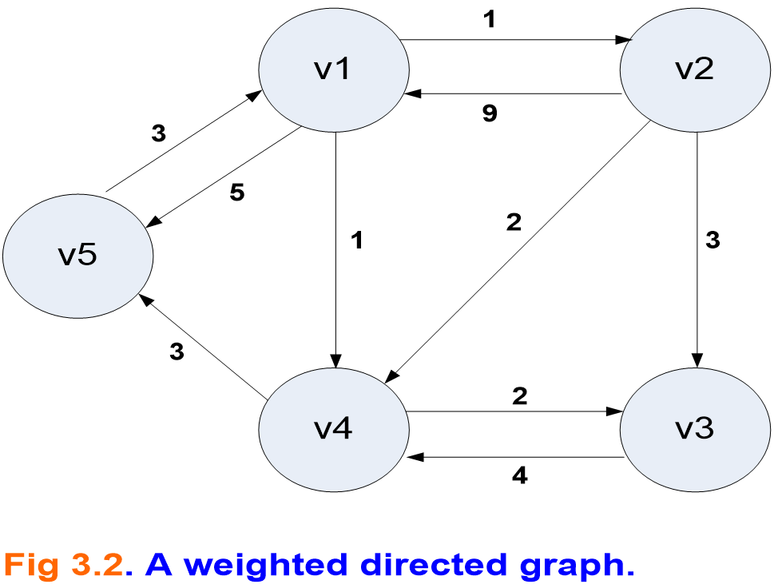
● sequence: [v1, v4, v3] is path.
● sequence: [v5, v4, v1] is not path.
● sequence: [v1, v4, v5, v1] is cycle.
● sequence: [v1, v4, v3] is simple path.
● sequence: [v1, v4, v5, v1, v2] is not simple path.
● length of a path: the sum of the weights on the path.

Slide 15
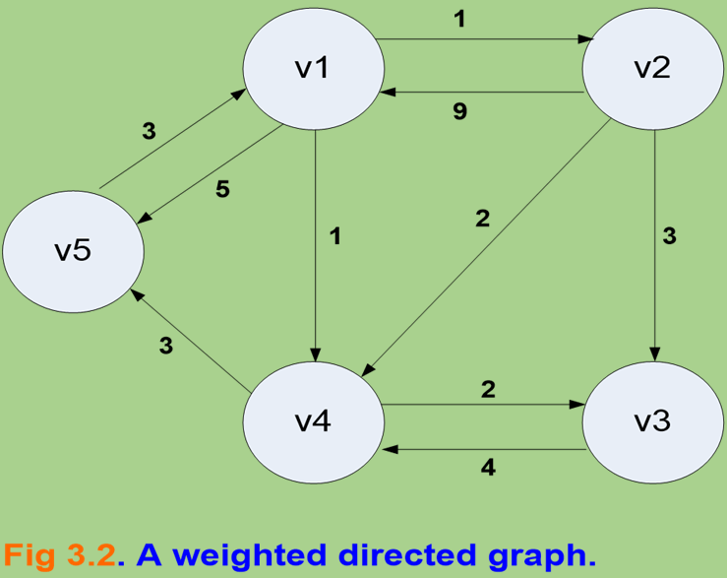
● A problem that has many application is finding the shortest paths
from each vertex to all other vertices.
● Clearly, a shortest path must be a simple path.
● [v1 → v3]: simple path (3개)
- length [v1, v2, v3] = 1 + 3 = 4
- length [v1, v4, v3] = 1 + 2 = 3
- length [v1, v2, v4, v3] = 1 + 2 + 2 = 5.
∴ shortest path: [v1, v4, v3]

Slide 16
● The shortest path problem is an optimization problem.
● There can be more than one candidate solution to an instance
of an optimization problem.
● Our goal is to find a more efficient algorithm.
Using dynamic programming, we create a cubic-time algorithm
the Shortest Paths problem.

Slide 17
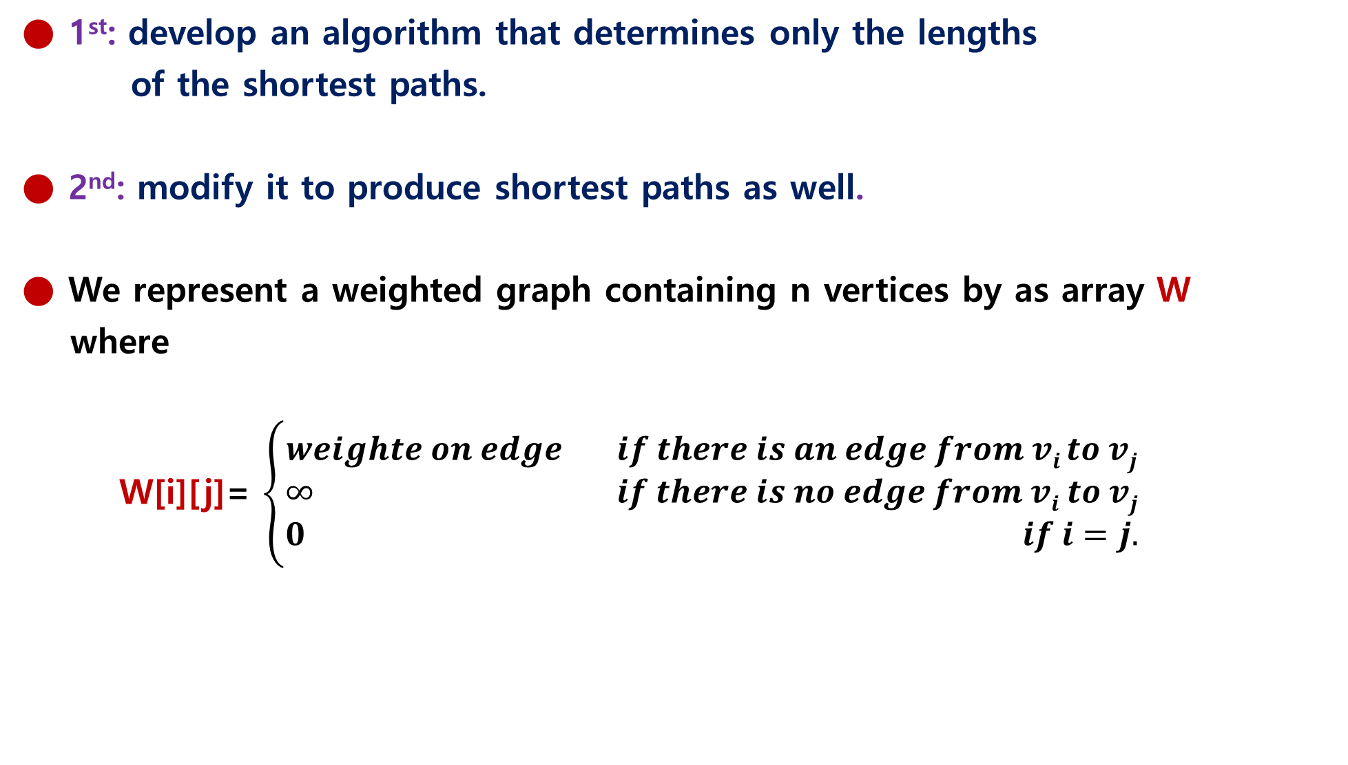
● 1st: develop an algorithm that determines only the lengths
of the shortest paths.
● 2nd: modify it to produce shortest paths as well.
● We represent a weighted graph containing n vertices by as array W
where
W[i][j]= $\left\{\begin{aligned}weighte on edge if there is an edge from vi to vj \\ ∞ if there is no edge from vi to vj \\ 0 if i=j.\end{aligned}\right.$

Slide 18
● The graph in Fig 3-2 is represented in manner in Fig 3-3.
● The array D in Fig 3-3 contains the lengths of the shortest paths
in the graph.

Slide 19

▣ [예제 1] : D[3][5] ?
● [v3 → v5]의 최단 거리의 길이 = 7
∴ length [v3, v4, v5] = 4 + 3 = 7

Slide 20
● If we can develop a way to calculate the value in D from those in W,
we will have an algorithm for the Shortest Paths problem.
● we accomplish this by creating a sequence of n + 1 arrays D^{(k)},
where 0 ≤ k ≤ n and where
D^{(k)}[i][j]= length of a shortest path from v_{i} to v_{j} using only vertices
in the set {v₁, v₂, ∙ ∙ ∙, v_{k}} as intermediate vertices.
● Before showing why this enables us to compute D from W,
let’s illustrate the meaning of the items in these arrays.

Slide 21

▣ [Example 3.2] : We will calculate some exemplary values
of D^{(k)}[i][j] for the graph in Fig 3.2.
1) D⁽⁰⁾[2][5] = length[v2, v5] = ∞

Slide 22

2) D⁽¹⁾[2][5] = minimum(length[v2, v5], length[v2, v1, v5])
= minimum(∞, 14) = 14.

Slide 23
3) D⁽²⁾[2][5] = D⁽¹⁾[2][5] = 14. { For any graph these are equal because a
shortest path starting at v2 cannot pass through v2.
}

Slide 24
4) D⁽³⁾[2][5] = D⁽²⁾[2][5] = 14. { For this graph these are equal because including
v3 yields no new paths from v2 to v5.
}

Slide 25
5) D⁽⁴⁾[2][5] = minimum(length[v2, v1, v5], length[v2, v4, v5],
length[v2, v1, v4, v5], length[v2, v3, v4, v5])
= minimum(14, 5, 13, 10) = 5.

Slide 26
6) D⁽⁵⁾[2][5] = D⁽⁴⁾[2][5] = 5. { For any graph these are equal because a
shortest path ending at v5 cannot pass through v5.
}

Slide 27
∴ The last value computed, D⁽⁵⁾[2][5], is the length of a shortest path
from v2 that is allowed to pass through any of the other vertices.
This means that it is the length of a shortest path.

Slide 28
● D^{(n)}[i][j] : the length of a shortest path from v_{i} to v_{j}
that is allowed to pass through any of the other vertices,
it is the length of a shortest path from v_{i} to v_{j}.
● D⁽⁰⁾[i][j] : the length of a shortest path that is not allowed to pass
through any other vertices, it is the weight on the edge
from v_{i} to v_{j}.
● We have established that
D⁽⁰⁾ = W and D^{(n)} = D

Slide 29
● Therefore, to determine D from W
we need only find a way to obtain D^{(n)} from D⁽⁰⁾.
● The steps for using dynamic programming to accomplish this are as follows:
1. Establish a recursive property (process) with which we can compute D^{(k)} from D^{(k-1)}. 2. Solve an instance of the problem in a bottom-up fashion by repeating the process (established in step1) for k = 1 to n. This creates the sequence D⁽⁰⁾, D⁽¹⁾, D⁽²⁾ ∙ ∙ ∙ , D^{(n)}. W D We accomplish Step 1 by considering two cases:

Slide 30

● Case 1): At least one shortest path v_{i} to v_{j}, using only vertices in {v₁ , v₂, ∙ ∙ ∙, v_{k}}
as intermediate vertices, does not use v_{k}. Then
D^{(k)}[i][j] = D^{(k-1)}[i][j]. ---------- (3.3)
- ex): An example of this case in Figure 3.2 is that
D⁽⁵⁾[1][3] = D⁽⁴⁾[1][3] = 3,
because when we include vertex v₅ , the shortest path from v₁ to v₃ is still [v₁,v₄,v₃].

Slide 31
● Case 2): All shortest path from v_{i} to v_{j}, using only vertices in {v₁ , v₂, ∙ ∙ ∙, v_{k}}
as intermediate vertices, do use v_{k}. In this case any shortest path appears
as in Fig 3.4.

Slide 32
● Because v_{k} cannot be an intermediate vertex on the subpath from v_{i} to v_{k},
that subpath uses only vertices in {v₁ , v₂, ∙ ∙ ∙, v_{k-1}} as intermediates.
● This implies that the subpath’s length must be equal to D^{(k-1)}[i][k] for the following reasons.
1st) The subpath’s length cannot be shorter because D^{(k-1)}[i][k] is the length
of a shortest path from v₁ to v_{k} using only vertices in {v₁ , v₂, ∙ ∙ ∙, v_{k-1}} as intermediates.
2nd) The subpath’s length cannot be longer because if it were, we could replace it
in Fig 3-4 is a shortest path. Similarly, the length of the subpath from v_{k} in Fig 3-4
must be equal to D^{(k-1)}[k][j]. Therefore, in the second case
D^{(k)}[i][j] = D^{(k-1)}[i][k] + D^{(k-1)}[k][j]. ---------- (3.4)
- ex): An example of the second case in Figure 3.2 is that
D⁽²⁾[5][3] = 7 = 4 + 3 = D⁽¹⁾[5][2] + D⁽¹⁾[2][3].

Slide 33
● Because we must have either Case 1 or Case 2, the value of D^{(k)}[i][j] is the minimum
of the values on the right in Equalities 3.3 and 3.4.
This means that we can determine D^{(k)} from D^{(k-1)} as follows:
D^{(k)}[i][j] = minimum(D^{(k-1)}[i][j], D^{(k-1)}[i][k] + D^{(k-1)}[k][j] .
case 1 case 2
● We have accomplished Step 1 in the development of a dynamic programming algorithm.
To accomplish Step 2, we use the recursive property in Step 1 to create the sequence
of array shown in Expression 3.2.
● Let’s do an example showing how each of these arrays is computed from the previous one.
D^{(k)}[i][j] = minimum(D^{(k-1)}[i][j], D^{(k-1)}[i][k] + D^{(k-1)}[k][j]).

Slide 34

▣ [Example 3.3] Given the graph in Fig 3-2, which is represented by the
adjacency matrix W in Fig 3-3, some simple computations are
as follows (recall that D⁽⁰⁾ ⁼ W) :

Slide 35
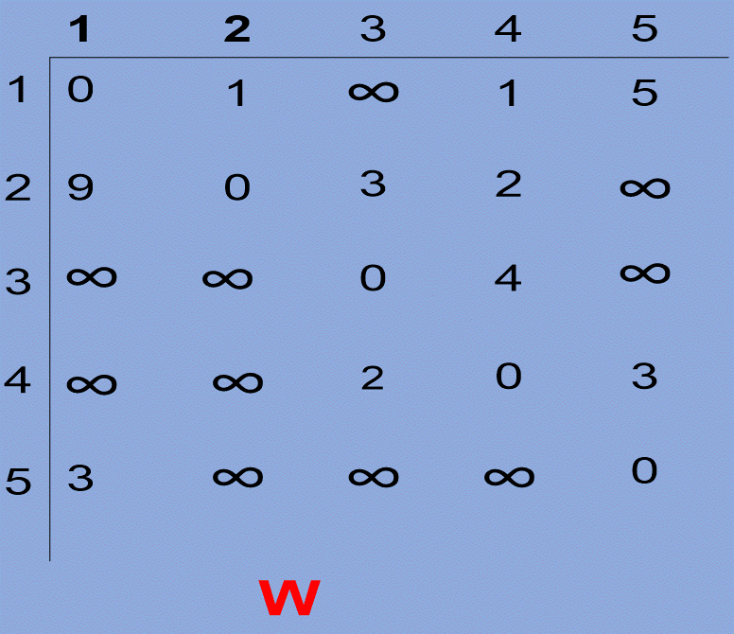
● D⁽¹⁾[2][4] = minimum(D⁽⁰⁾[2][4], D⁽⁰⁾[2][1] + D⁽⁰⁾[1][4])
= minimum(2, 9+1) = 2.
● D⁽¹⁾[5][2] = minimum(D⁽⁰⁾[5][2], D⁽⁰⁾[5][1] + D⁽⁰⁾[1][2])
= minimum(∞, 3+1) = 4.
● D⁽¹⁾[5][4] = minimum(D⁽⁰⁾[5][4], D⁽⁰⁾[5][1] + D⁽⁰⁾[1][4])
= minimum(∞, 3+1) = 4

Slide 36

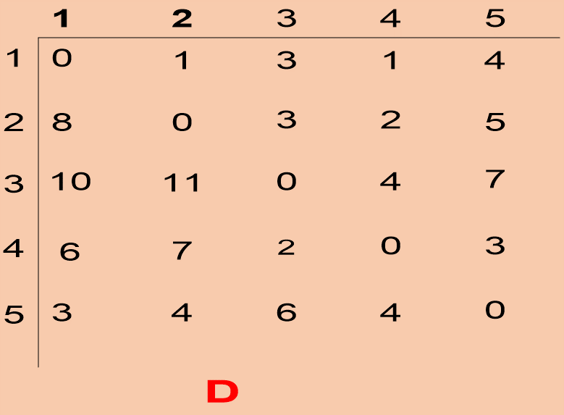
● Once the which array D⁽¹⁾ is computed, the array D⁽²⁾ is computed.
A simple computation is
D⁽²⁾[5][4] = minimum(D⁽¹⁾[5][4], D⁽¹⁾[5][2] + D⁽¹⁾[2][4])
= minimum(4, 4+2) = 4.

Slide 37
● After computing of all of D⁽²⁾, we continue in sequence until D⁽⁵⁾ is computed.
This final array is D, the lengths of the shortest paths.
It appears on the right in Fig 3-3.

Slide 38
▣ [Algorithm 3.3] : Floyd’s Algorithm for Shortest Paths
Problem: Compute the shortest paths.
Inputs: A weighted, directed graph and n, the number of vertices in the graph.
The graph is represented by a two-dimensional array W, which has both its rows
and columns indexed from 1 to n, where W[i][j] is the weight on the edge
from the i^{th} vertex to the i^{th} vertex.
Outputs: A two-dimensional array D, which has both its rows and columns indexed from 1 to n,
where D[i][j] is the length of a shortest path from the i^{th} vertex to the j^{th} vertex.
void floyd (int n, const number W[ ][ ], number D[ ][ ]) { index i, j, k; D = W; for (k =1; k <= n; k++) for (i =1; i <= n; i++) for (j =1; j <= n; j++) D[i][j] = minimum(D[i][j], D[i][k] + D[k][j]); }

